Slide 1
INFO 7390 Final Project
PORTUGUESE BANKING DATASET
Team :
Utkarsh Kakkar
Chaitanya Nakhare
Nidhi Goyal
Aaradhy Sharma

Slide 2
Objective
There has been a revenue decline for the Portuguese bank, and we would like to know what actions to take.
After investigation, we found out that the root cause is that the clients are not depositing as frequently as before.
We would like to identify existing clients that have higher chance to subscribe for a term deposit and focus marketing effort on such clients.
The classification goal is to predict if the client will subscribe (1/0) a term deposit (variable y).

Slide 3
Packages Used
The following are the packages used with their needs described below:
NumPy: For basic Mathematical functions
Pandas: For importing data and creating data-frame and extraction
Sci-kit learn: Implementing Machine Learning Algorithms
PyCaret: Comparing various classification models and returning the best models
Pandas_Profiling: For data visualization and analysis
Seaborn: For visualizing our records
XGBoost: Implementing XGBoost that take D-Matrix as an input

Slide 4
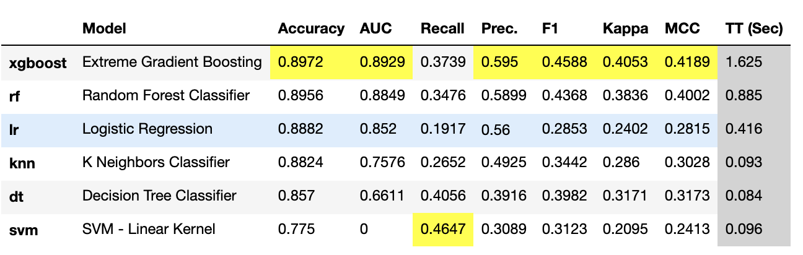
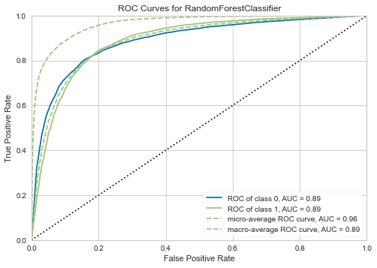
PyCaret
PyCaret is an open-source, low-code machine learning library in Python that aims to reduce the cycle time from hypothesis to insights and deploying the models and plotting.
Multiple models have been deployed and compared.

Slide 5
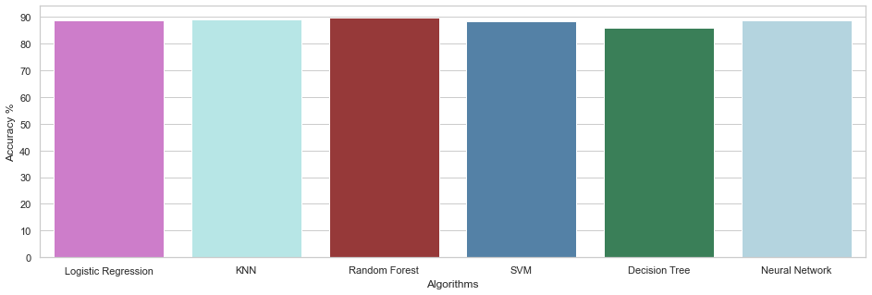
Algorithms Implemented
Logistic Regression
K-Nearest Neighbors - KNN
Random Forest
SVM
Decision Tree
MLP Classifier
Scaling Performed are :
Standard Scaling
Min Max Scaling
Robust Scaling.

Slide 6
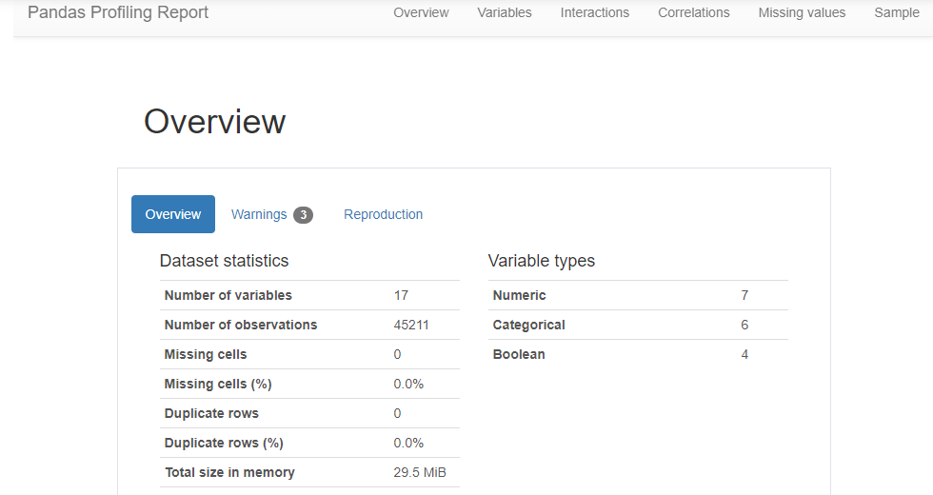
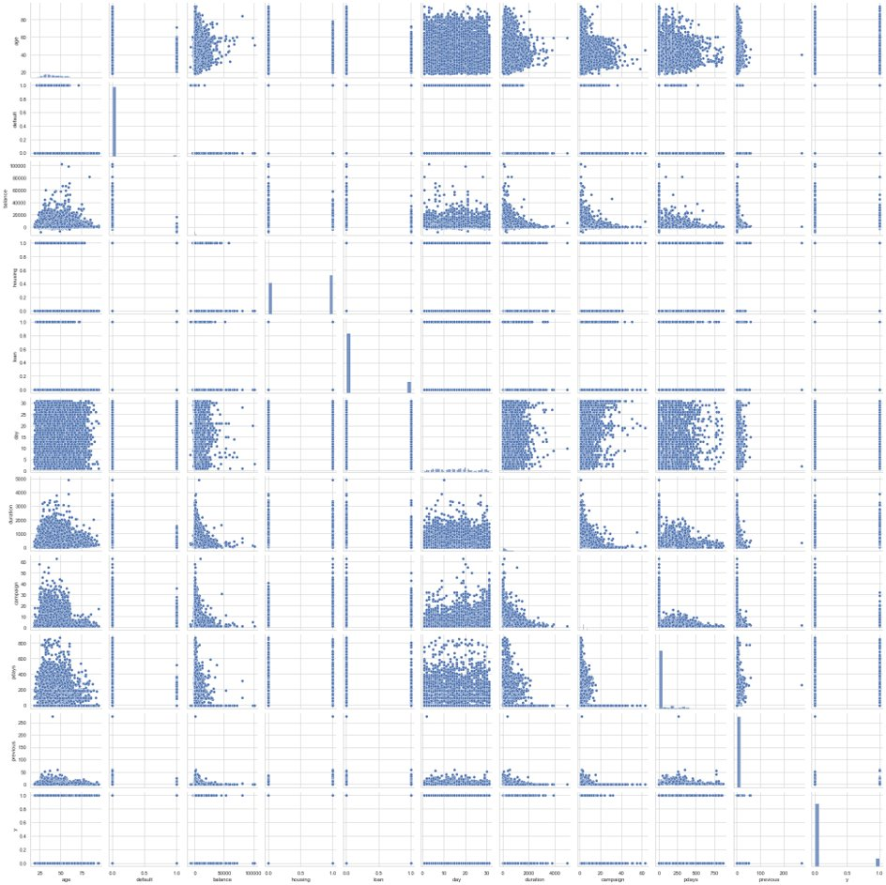
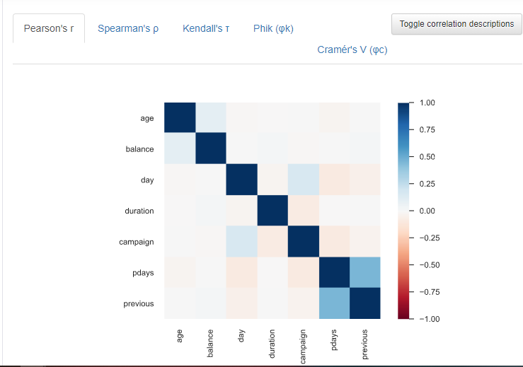
Exploratory Data Analysis
We used pandas profiling for EDA.

Slide 7
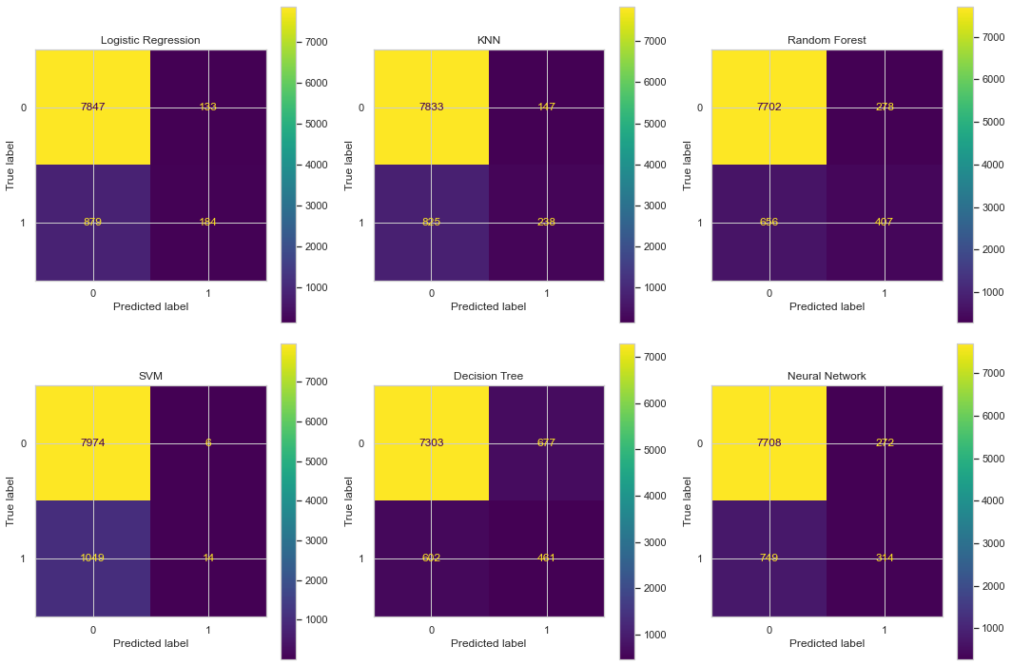
We have used Confusion Matrix as a Performance metric for our binary classifier.
Multiple models have been deployed and compared.

Slide 8
Inference
We achieved following observations after having data analyzed and visualized:
Education: Most people have university level education while illiterate people are very less.
Random Forest classification model has a high accuracy for the above dataset thus it would be apt to understand bank analysis.
For our case, Fall-out or FPR and specificity would be an important metric to choose a model as these will tell us how many customers did not actually subscribe for a term, but the model predicted and labeled them as subscribed which would slash down banks' business/revenue for that term.
"Lower" specificity and fall-out is ideal for this USE case. Hence, we choose the model that has better/higher accuracy score which is quintessential for a successful classification model given that it has a lower specificity and fall-out score.
Thus, our goal here would be the Fall-out and then implement it as our business model/USE case.
We can confidently say that having a high metric say accuracy doesn't necessarily imply a perfect business model. For the bank XGBoost and Random Forest would be a good way of classifying the customers.

Slide 9
References
https://scikit-learn.org/stable/modules/generated/sklearn.linear_model.LogisticRegression.html
https://scikit-learn.org/stable/modules/generated/sklearn.neighbors.KNeighborsClassifier.html
https://scikit-learn.org/stable/modules/generated/sklearn.ensemble.RandomForestClassifier.html
https://scikit-learn.org/stable/modules/generated/sklearn.svm.SVC.html
https://scikit-learn.org/stable/modules/generated/sklearn.tree.DecisionTreeClassifier.html
https://scikit-learn.org/stable/modules/generated/sklearn.neural_network.MLPClassifier.html#sklearn.neural_network.MLPClassifier
https://scikit-learn.org/stable/auto_examples/model_selection/plot_confusion_matrix.html
https://seaborn.pydata.org/generated/seaborn.barplot.html
https://github.com/pycaret/pycaret
https://pycaret.org/compare-models/

